Slide 1
Category review: Chips
AUGUST 2023
Retail Analytics
Brand note: If client logo is not required, use alternate title page layout right click slide thumbnail > Layout > Title

Slide 2
Notes:
To view Privacy video explaining how important data privacy is to Quantium, please click here: https://www.youtube.com/watch?v=Zq1QDAkoRzU
or here Q:\Company Reference\Brand & Design\Brand videos\Q Privacy.mp4
At Quantium, we believe that data is the behavioural footprint of humanity and that it has to be treated with the utmost care and responsibility.
Histories, attitudes, indeed lives are stored within it in ways that aren’t always apparent – and that’s what makes its potential so powerful.
To work with it responsibly, sensitively, we set ourselves the highest data privacy protection and governance standards.
We have spent 17 years perfecting privacy-by-design and secure-by-design principles. Central to this is not holding any personally identifiable information about people –
we neither receive it, and put the necessary protections in place to be unable to decipher it.
Every aspect of handling data is safeguarded: from its de-identification, to its encryption – data security is paramount and of the highest grade.
We pride ourselves on gaining the trust of iconic organisations around the world through years of securely working with their data,
and in turn the trust that builds with their stakeholders.

Slide 3
Executive summary
01
Data preparation and Customer Analytics
Aim of this task are :
Examine transaction data - check for missing data, anomalies, outliers and clean them
Examine customer data - similar to above transaction data
Data analysis and customer segments - create charts and graphs, note trends and insights
Deep dive into customer segments - determine which segments should be targeted
02
- Experimentation and Uplift Testing
Aim of this task are :
Select control stores – Explore data, define metrics, visualize graphs
2. Assessment of the trial – insights/trends by comparing trial stores with control stores
3. Collate findings – summarize and provide recommendations.

Slide 4
01
Category

Slide 5
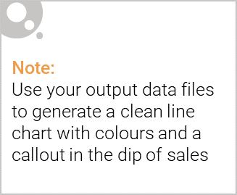
Older Families: Focus on the Budget segment. Strength: Frequent purchase. We can give promotions that encourages more frequency of purchase. Strength: High quantity of chips purchased per visit. We can give promotions that encourage them to buy more quantity of chips per purchase.- Young Singles/Couples: Focus on the Mainstream segment. This segment is the only segment that had Doritos as their 2nd most purchased brand (after Kettle). To specifically target this segment it might be a good idea to collaborate with Doritos merchant to do some branding promotion catered to "Young Singles/Couples - Mainstream" segment. Strength: Population quantity. We can spend more effort on making sure our promotions reach them, and it reaches them frequently.- Retirees: Focus on the Mainstream segment. Strength: Population quantity. Again, since their population quantity is the contributor to the high total sales, we should spend more effort on making sure our promotions reaches as many of them as possible and frequent.- General: All segments has Kettle as the most frequently purchased brand, and 175gr (regardless of brand) followed by 150gr as the preferred chip size. When promoting chips in general to all segments it is good to take advantage of these two points.

Slide 6
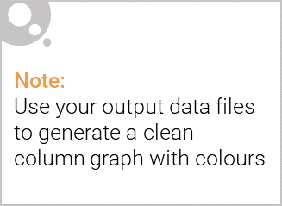
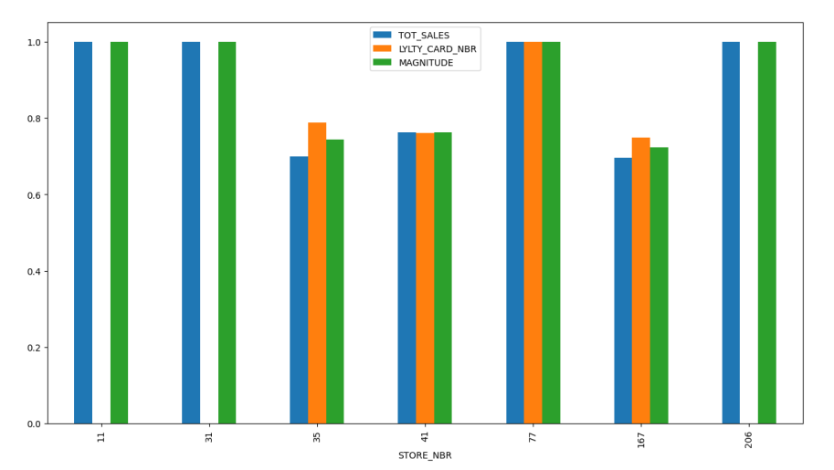

Slide 7
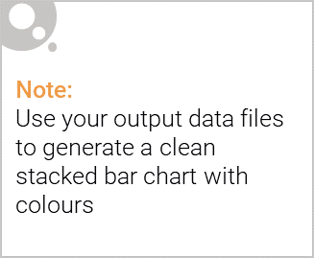
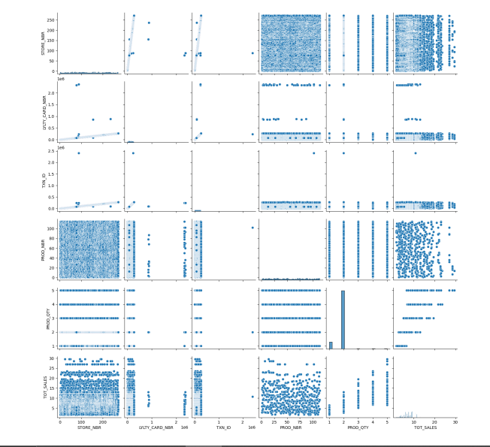
Editable (delete this)

Slide 8
02
Trial store performance

Slide 9
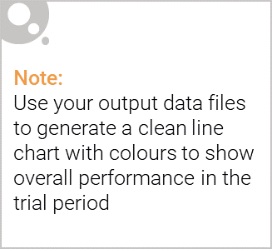
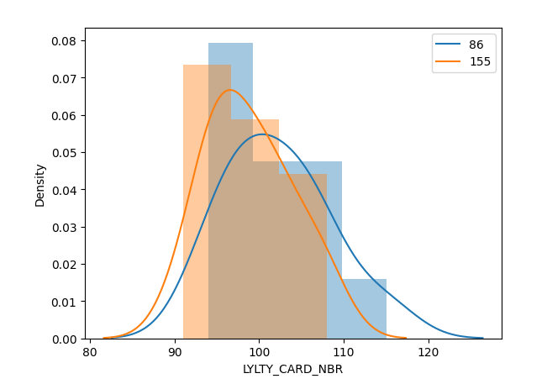
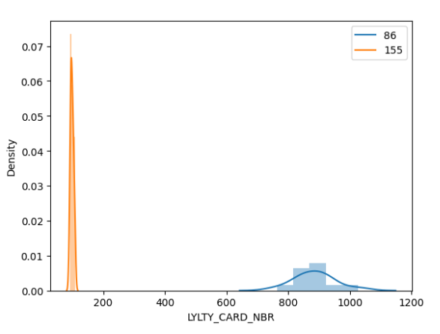
Insights and Trends-
We can see that Trial store 77 sales for Feb, March, and April exceeds 95% threshold of control store. Same goes to store 86 sales for all 3 trial months.

Slide 10
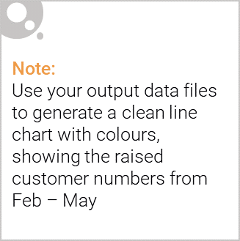
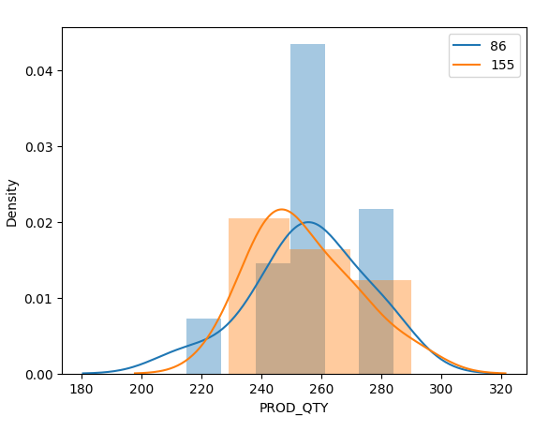
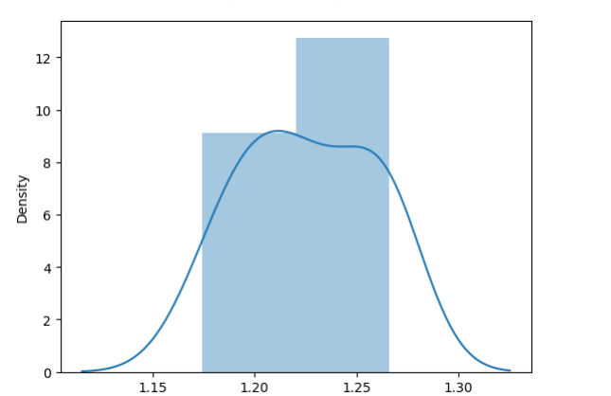
Trial store 77: Control store 2332.
Trial store 86: Control store 1553.
Trial store 88: Control store 404.
Both trial store 77 and 86 showed significant increase in Total Sales and Number of Customers during trial period. But not for trial store 88. Perhaps the client knows if there's anything about trial 88 that differs it from the other two trial.5. Overall the trial showed positive significant result.

